Slide 1
OUR Plate: Models For Culturally Inclusive Nutrition Education
Rita Ntim-Gyakari, Dr. Sandra Bargainnier, Dr. Najah Zaaeed

Slide 2
Introduction
Choose MyPlate.gov is a public health campaign sponsored by the United States Department of Agriculture (USDA). Its goal is to help schools, health agencies, and individuals make food choices to improve health outcomes.
More than 40 million people living in the US were born in another country. That is one-fifth of world’s immigrants as of 2017 (Radford, J. 2019)
Immigrants are 13.6% of U.S population (Radford, J. 2019)
In 2018, 22,491 refugees were resettled in the US
Refugees and Immigrants to the United States face multiple challenges in languages, health care, culture, jobs and many more (Chiton et al. 2009).
The purpose of this research is to analyze the USDA Choose MyPlate website for cultural appropriateness and inclusion
To highlight the importance of nutrition education programs to reduce health consequences in these communities.

Slide 3
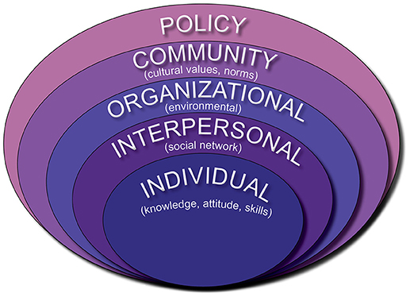
Theoretical Framework
Food availability
Food access
Food utilization

Slide 4
Methods
Intensively reviewed websites and literature
Intensively analyzed the USDA MyPlate government website for images, activities and meal plans that were representative of culturally responsive nutrition recommendation
Developed an informal assessment by talking to family and friends to create OUR PLATE sample graphics that are more inclusive of the diverse population in the United States

Slide 5
Comparison
USDA My Plate
Literature/Non-Profit Organizations
Food groups
Language
Plan
Recipes
Browse by Audience
Activities
Nutrition/Cooking Classes
Religion

Slide 6
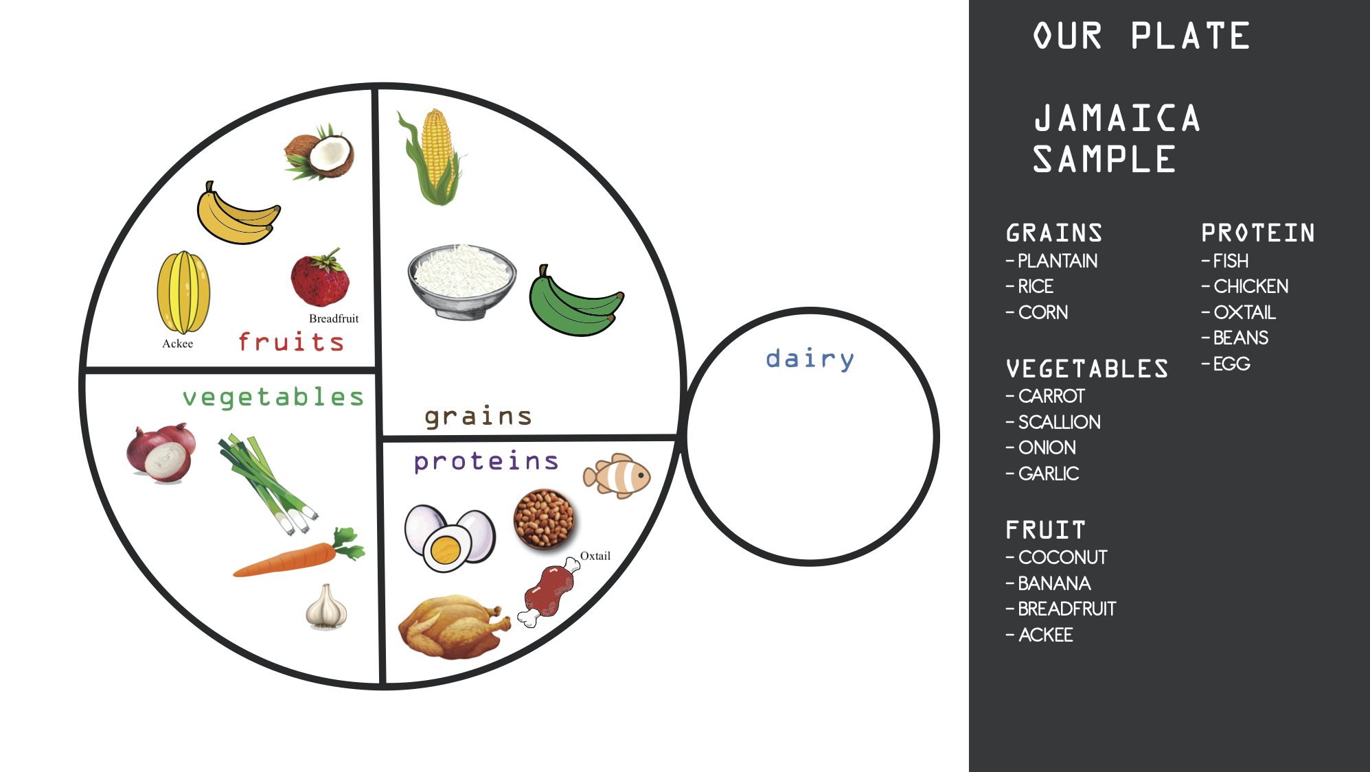
Results

Slide 7
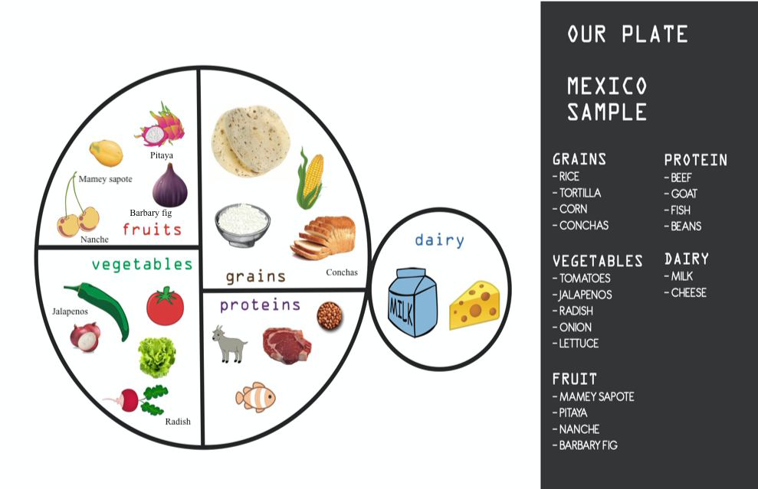
Results

Slide 8
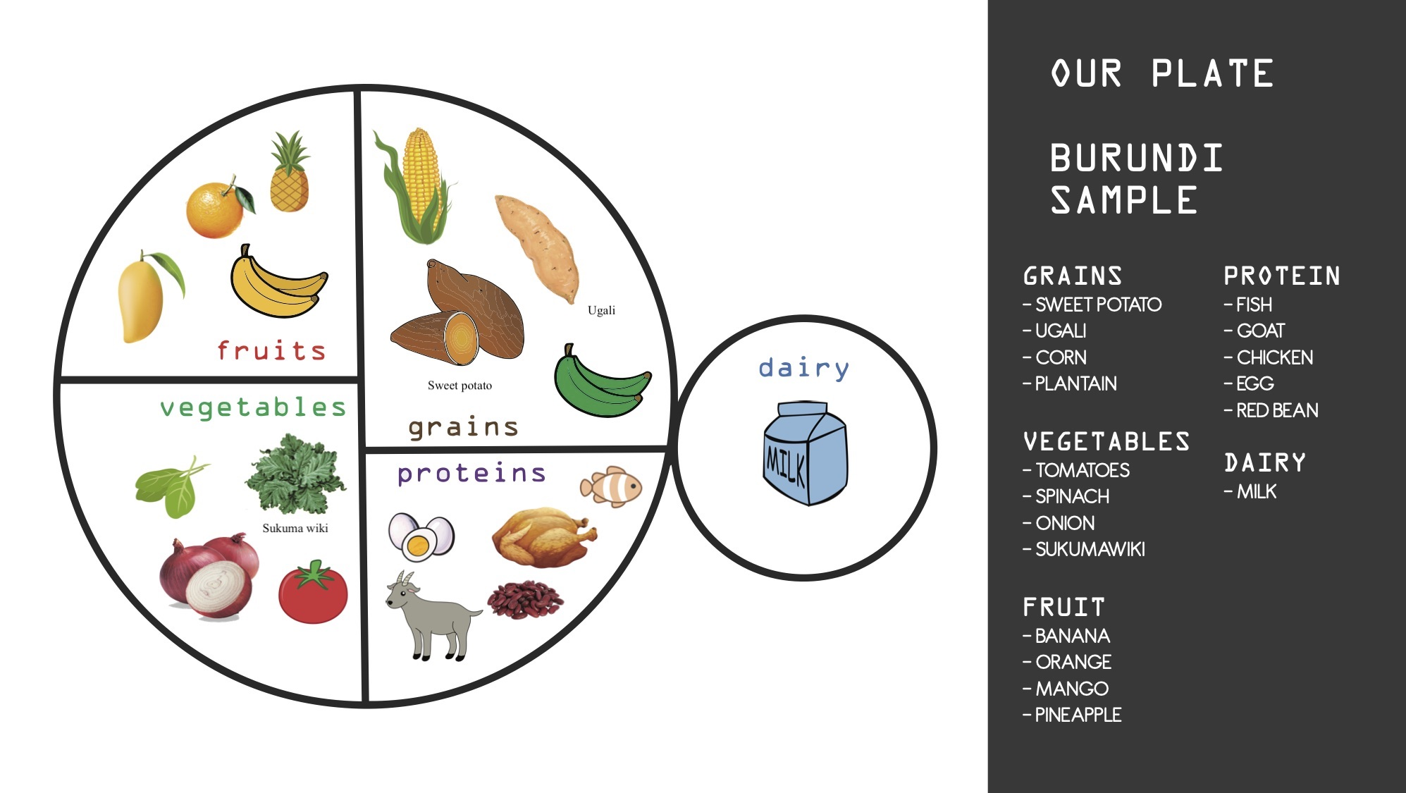
Results

Slide 9
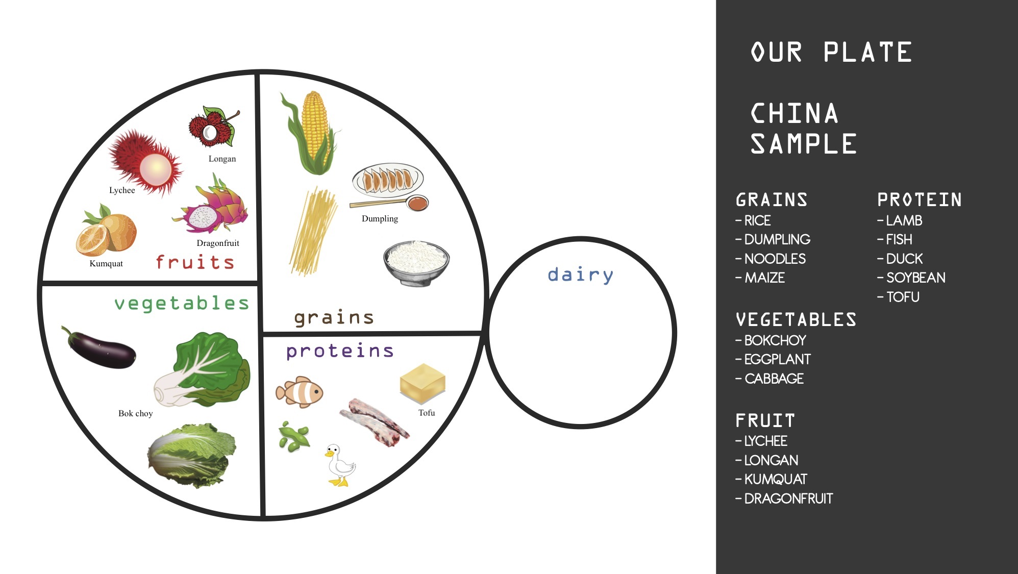
Results

Slide 10
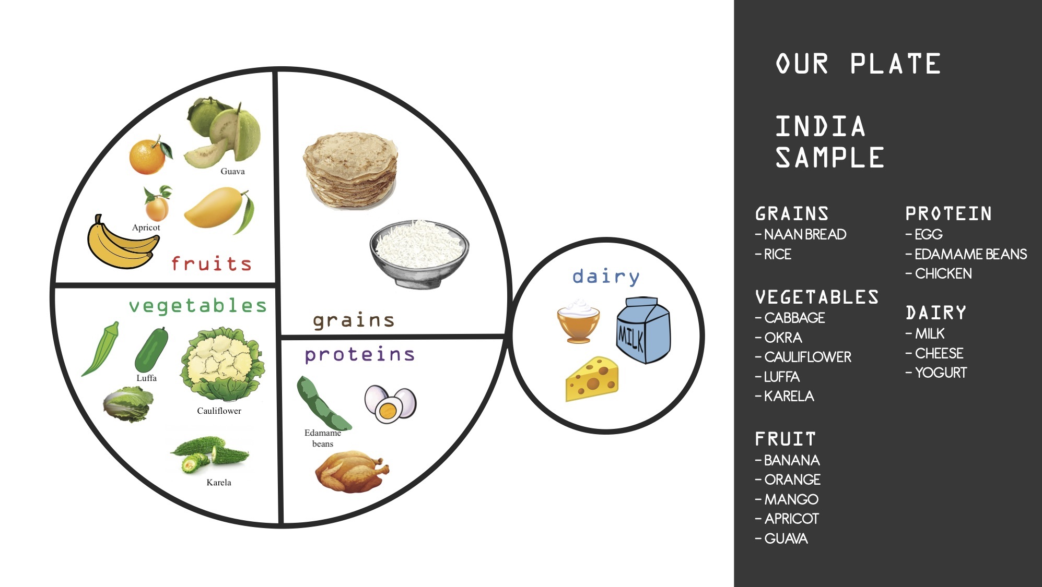
Results

Slide 11
Future Avenue
Cultural Inclusivity
Spices and eating rituals
Data from different backgrounds
Support of ethnic stores

Slide 12
References
Batalova, J., Batalova, J. B. J., Blizzard, B., & Bolter, J. (2020, February 14). Frequently Requested Statistics on Immigrants and Immigration in the United States. Retrieved from https://www.migrationpolicy.org/article/frequently-requested-statistics-immigrants-and-immigration-united-states#Geography
Chilton, M., M. M. Black, C. Berkowitz, P. H. Casey, J. Cook, D. Cutts, R. R. Jacobs, et al. 2009. “Food Insecurity and Risk of Poor Health Among US-Born Children of Immigrants.” American Journal of Public Health 99(3): 556–562.
Fraser, L., G. Clarke, J. Cade, and K. Edwards. 2012. “Fast Food and Obesity.” American Journal of Preventive Medicine 42 (5): E77-E85.
Gold, A., Yu, N., Buro, B., & Garden-Robinson, J. (2014). Discussion Map and Cooking Classes: Testing the Effectiveness of Teaching Food Safety to Immigrants and Refugees. Journal of Nutrition Education and Behavior, 46(6), 547–553. doi: 10.1016/j.jneb.2013.11.014
Nutritionists Cater Healthy Eating Programs to Immigrants: WNYC: New York Public Radio, Podcasts, Live Streaming Radio, News. (2012, March). Retrieved from https://www.wnyc.org/story/192190-healthy-eating-outreach-immigrants/
Radford, J. (2019, June 17). Key findings about U.S. immigrants. Retrieved from https://www.pewresearch.org/fact-tank/2019/06/17/key-findings-about-u-s-immigrants/

